Slide 1
InstaWeight
Atif Mehmood
Sayyada Sahar Fatima
Ateeb Ahmed

Slide 2
Problem Statement
Products - Depends on Body Size and Weight.
Weight - The most important Factor, effective in assessing the reproductive efficiency and growth performance of an animal.
Weight - To measure the correct dose of therapeutic pharmaceutical to treat diseases
Feed Based on Animal’s Weight, avoid underfeeding or overfeeding.
Weighing animal - A tedious task, requires manhandling

Slide 3
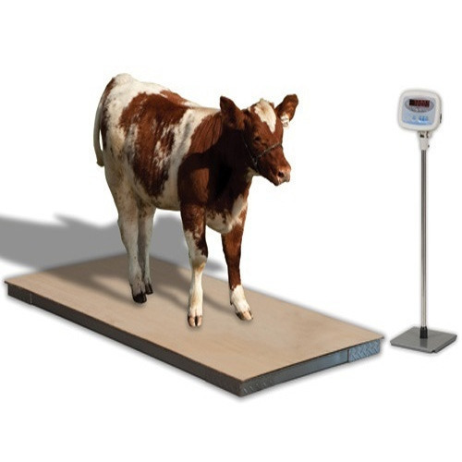
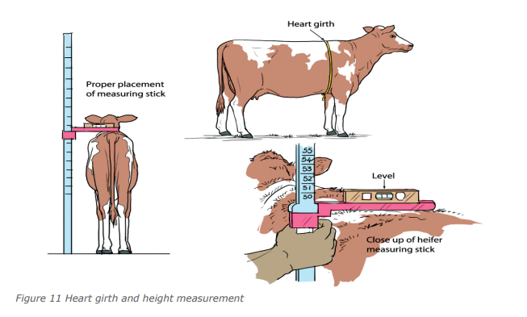
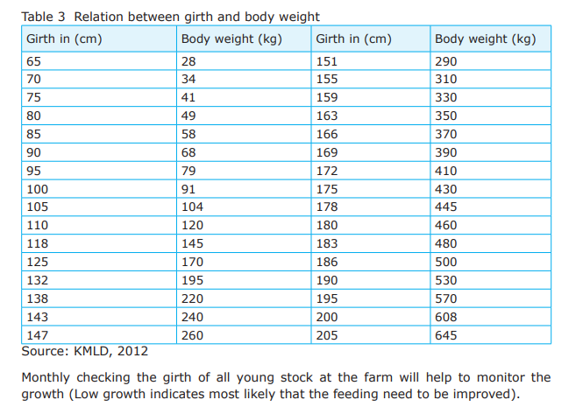
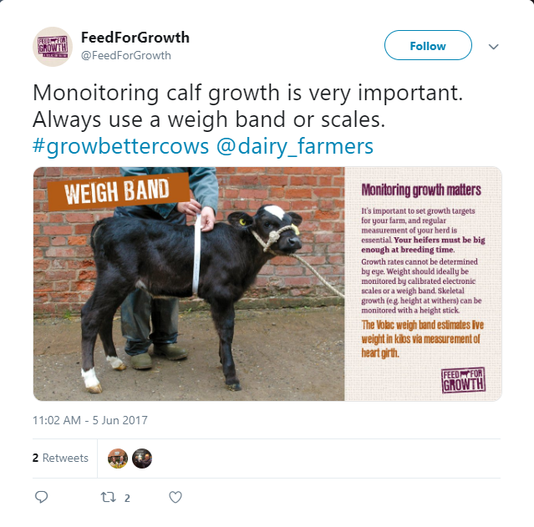
Existing Methods
Electronic Scale
Height, Heart Girth
Weigh Band

Slide 4
Problems with Existing Methods
Weighing balance cost 35,000 - 1,00,000 PKR.
Methods cause stress - Effect on animal growth.
Requires high maintenance cost.
Weighing requires a lot of manhandling.
It is prone to inaccuracies, as animal always be walking and that will also include inertia.
https://www.farmersweekly.co.za/farm-basics/how-to-livestock/stress-affects-livestock-health/

Slide 5
Our Proposed Solution
Reduce Time
Reduce Manpower
Reduce Cost
Weight estimation - By capturing images

Slide 6
Literature Review
Weight Estimation Using Image Analysis and Statistical Modelling: A Preliminary Study
The author automated the weight estimation system by using image processing techniques. The steps that are used in this approach as a part of image processing are following.
Object Detection
Segmentation
Filtering
Feature Extraction

Slide 7
Literature Review
Weight Estimation through Image Analysis
In this paper, image segmentation based technique has been used to segment out the region from the image and then using the dimension of the image object weight has been calculated using density based formula. According to the author, it was observed through this experimental process, results were 92%-94% accurate.
Preprocessing
Segmentation
Volume Calculation
Mass Calculation

Slide 8
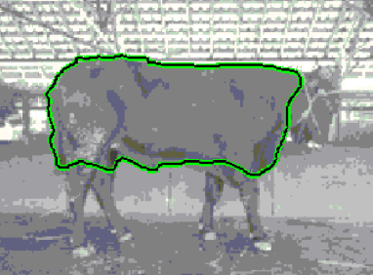
Literature Review
In this paper, captured the front and side images to estimate the weight. The research was done to estimate the cattle’s weight, in which the author detected the largest area using active contour and extracted the number of pixels from the images. In this research, 73% accuracy was achieved.

Slide 9
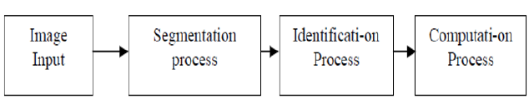
Literature Diagram
A measuring weight model of Timor's Beef Cattle based on image
The overall approach that is used to estimate the weight of cattle is by calculating the heart girth and body length of cattle.
Accuracy: 90% - 94%

Slide 10
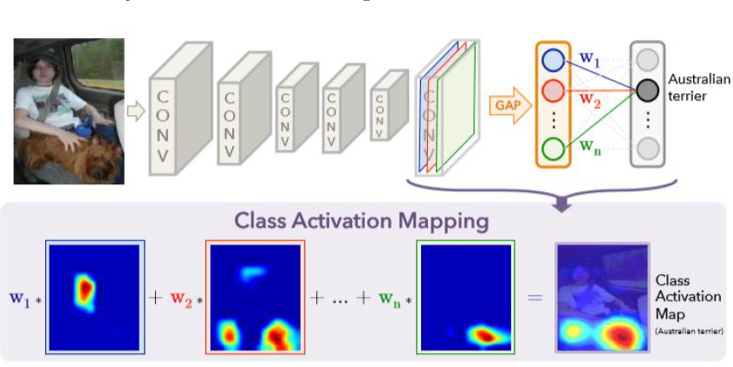
Literature Review
Learning Deep Features for Discriminative Localization
Visualizing the discriminative regions basically what CNN sees and using it to train for object localization.

Slide 11
Our Approach
None of the mentioned researchers incorporated the depth information
We have 2 different approaches

Slide 12
Heart Girth Measurement with Per-Pixel Depth
Heart girth measurement is the most reliable technique of estimating the weight
2 variables
Heart Girth
Body Diagonal/Length
This approach:
Require 1 images
Find inner and outer bounding boxes around the required body parts of animal from the Image of side view of the animal
Estimate the curvature using per pixel depth information
Get the number of pixels in both measurements a convert them
to real world measurements
Plug in to the formula, and Done!
Notes:
The second approach we looked into was the heart girth measurement with per pixel depth. We take the same measurements as the first approach. However this time we estimate the curvature using per pixel depth information

Slide 13
RGBD
Incorporated 3 channels (RGB) + Depth channel
Convolutional Neural Network - For weight estimation
Notes:
The Third approach is Rgb

Slide 14
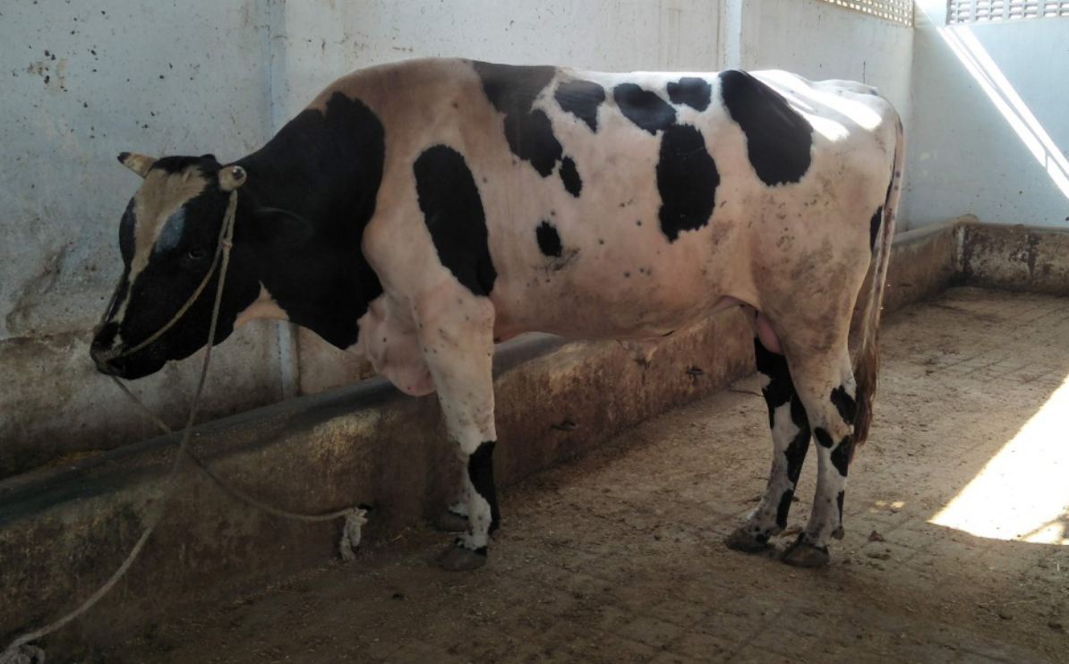
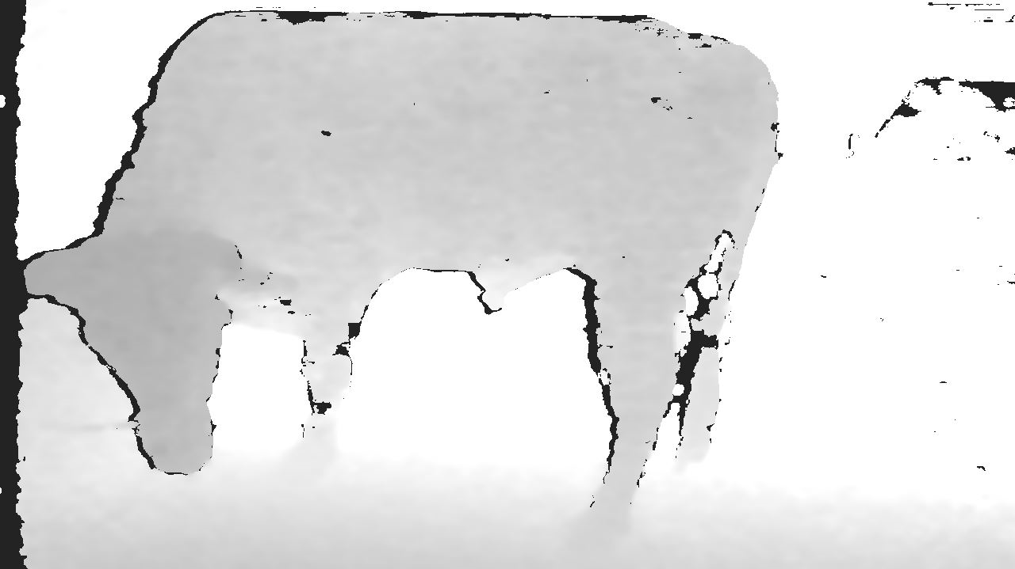
Workflow
Image Acquisition:
Original Image
Depth Image

Slide 15
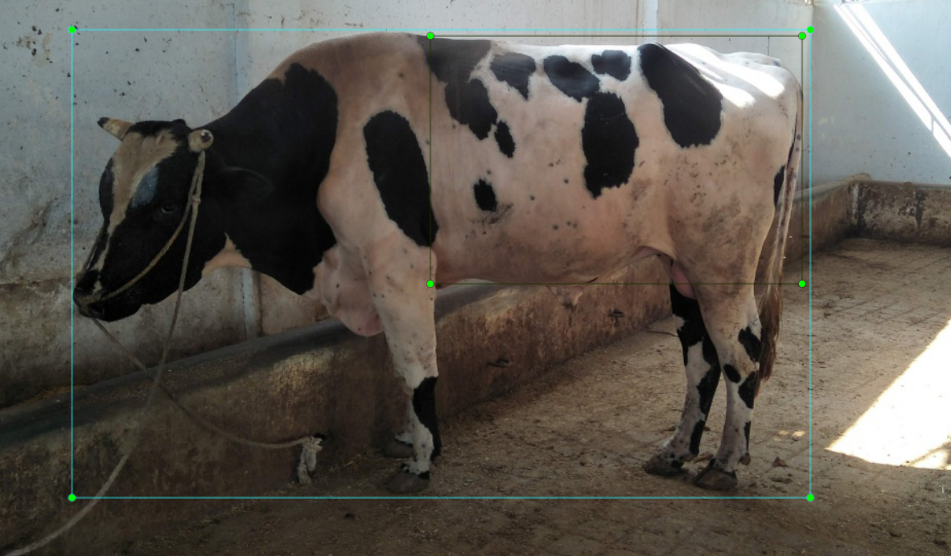
Workflow
2. Object Localization:

Slide 16
Workflow
3. Pixel Values and depth values:
2 measurements:
Heart Girth Measurements:
Heart Girth Pixel Vector: [p1, p2, p3 … pN]
Heart Girth Depth Per Pixel Vector: [dp1, dp2, dp3 … dpN]
Diagonal Pixel Vector
Diagonal Pixel Vector: [p1, p2, p3 … pN]
Diagonal Depth Per Pixel Vector: [dp1, dp2, dp3 … dpN]

Slide 17
Workflow
3. Conversion of Obtained measurements into real world measurements
Heart Girth Pixel Vector
Heart Girth Measurements in meters
Measurements Converter
Diagonal Pixel Vector
Heart Girth Depth Per Pixel Vector
Diagonal Measurements in meters
Diagonal Depth Per Pixel Vector

Slide 18
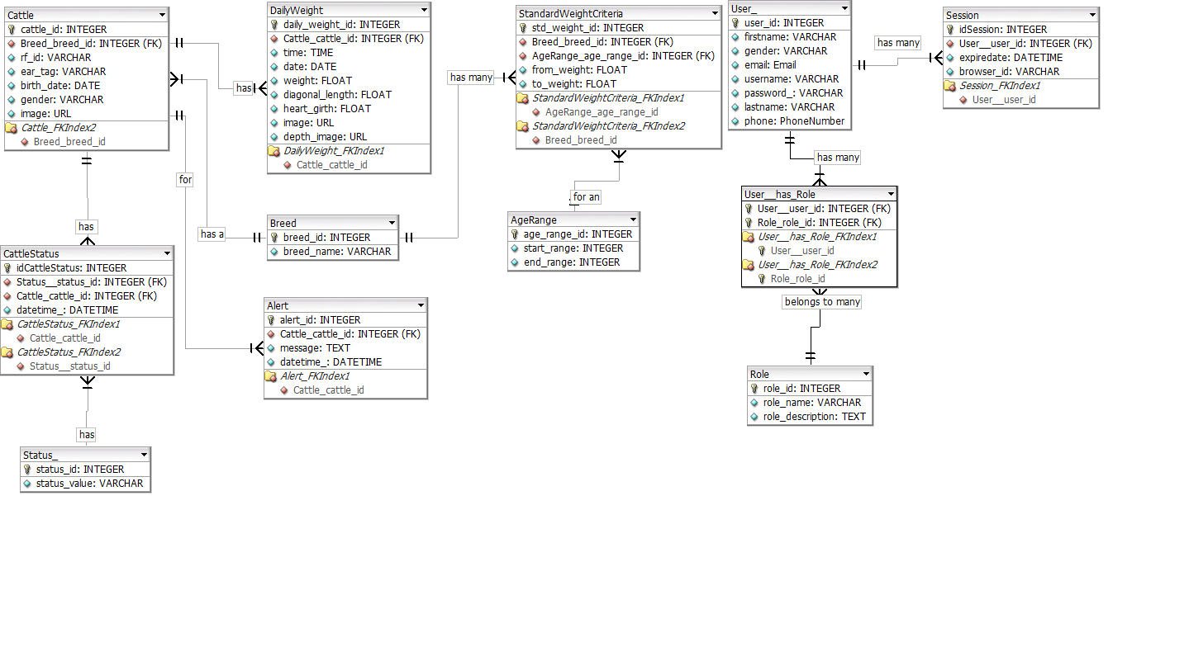
Entity Relationship Diagram

Slide 19
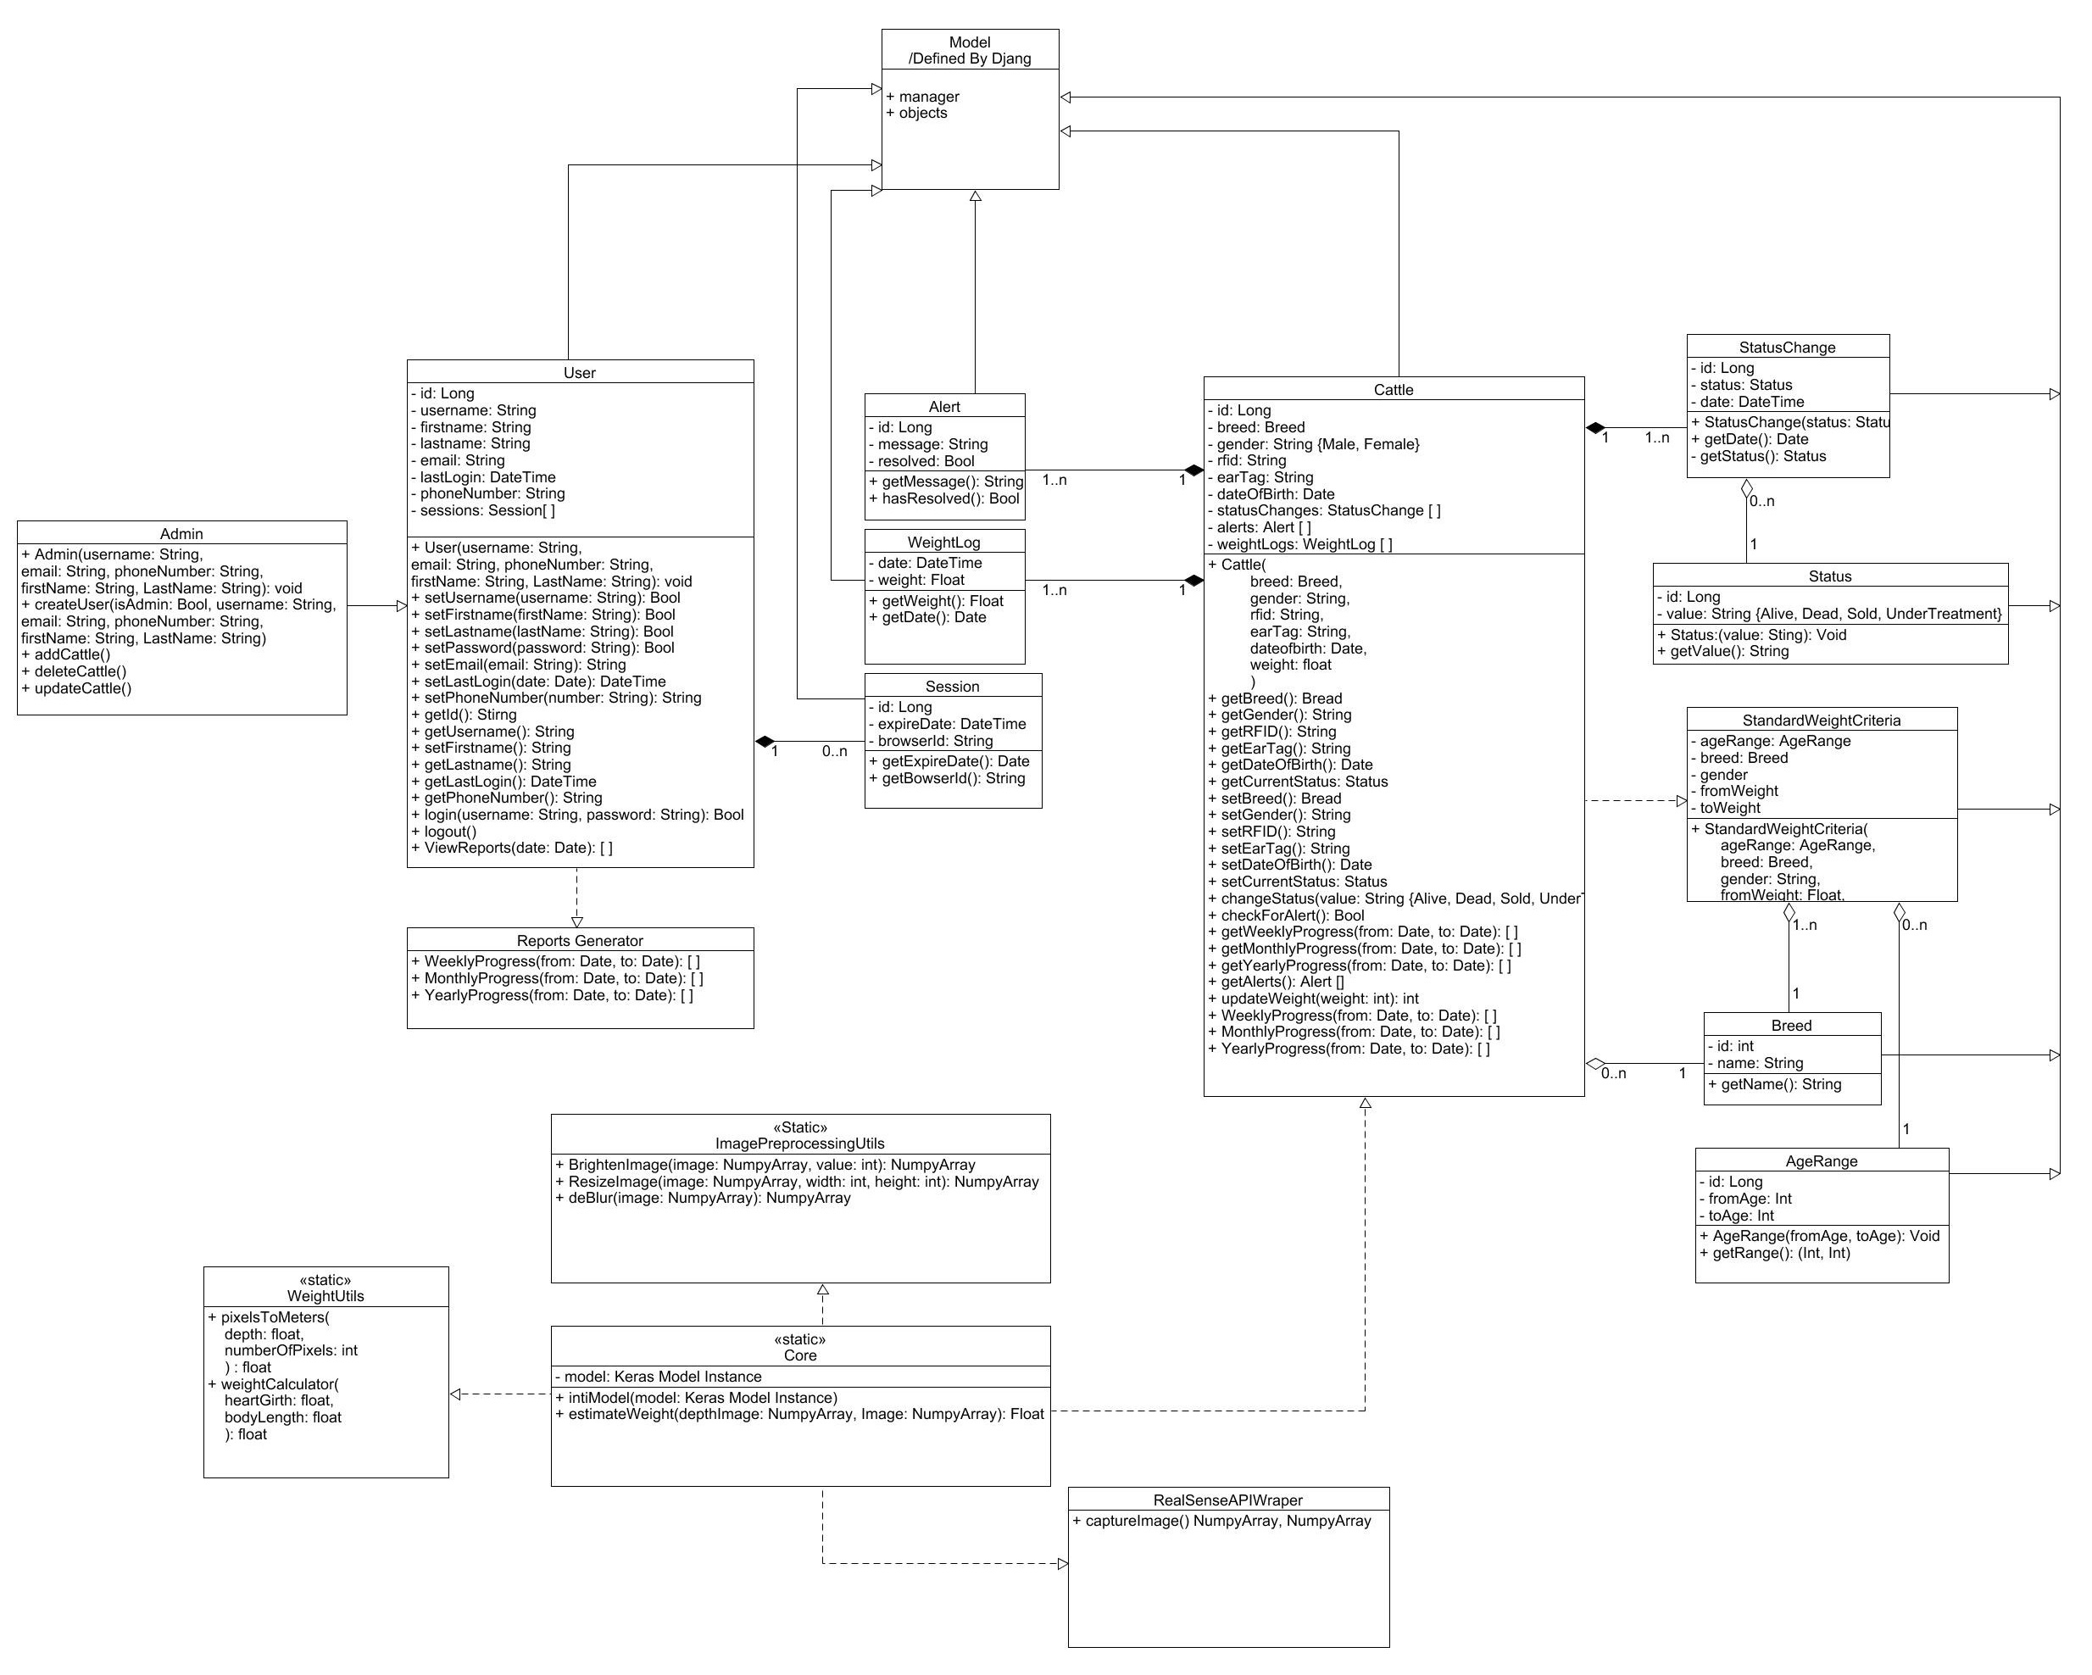
UML (Class Diagram)

Slide 20
Assumptions
One animal in a frame.
Breed specific work -
Object is not tilled. Parallel to the camera.
Intel realsense D-415 - For Image acquisition.
Image Capturing range:
Min: 2 meters
Max: 4 meters

Slide 21
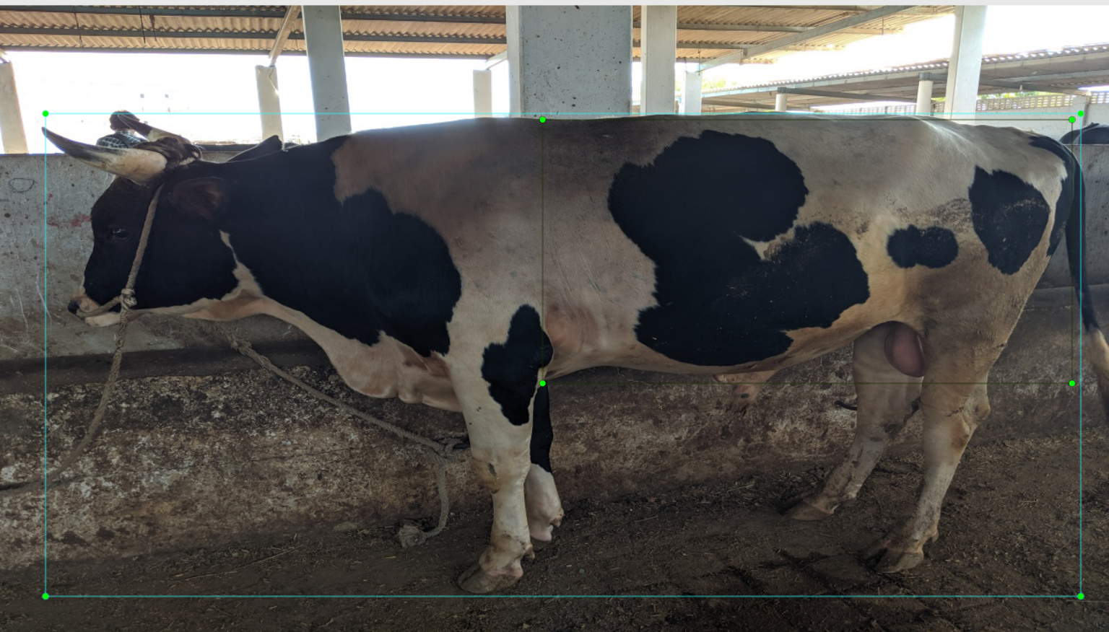
Dataset V1
Hand annotated images: 229
Useable images from Images scrapped from web: 300
Only side views of Cattle
No depth information
No weight labels
Will be use for Semantic Segmentation and Cattle detection
Total Images: 529

Slide 22
Augmentation on V1
From each image - 3 augmented image
Brightened Image (gamma = 2.0)
Darkened Image and introduced noise to simulate low light conditions.
Flipped Images on vertical axis
Total Number of Images after Augmentation: 2,116

Slide 23
Experiments on Dataset V1
Tried to solve as a Localization problem
Base networks VGG16, Resnet
Initial trained only fully connected layers for two bounding boxes.
Trained only fully connected layers for only one bounding box.
Unfreeze some Conv layers and trained for two bounding boxes.
Unfreeze some Conv layers and trained for one bounding boxes.
Overfitted for Demo Purposes.
GAP for Localization

Slide 24
Object Localization

Slide 25
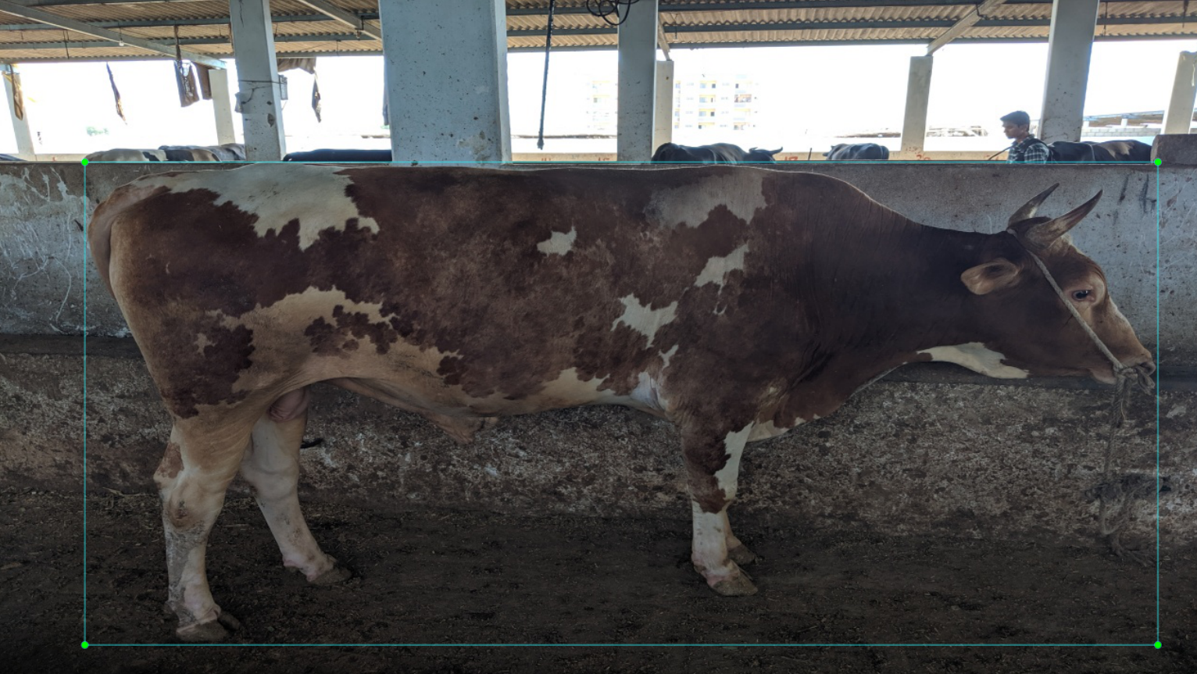
Aim: Object Localization
Take a bounding box around animal

Slide 26
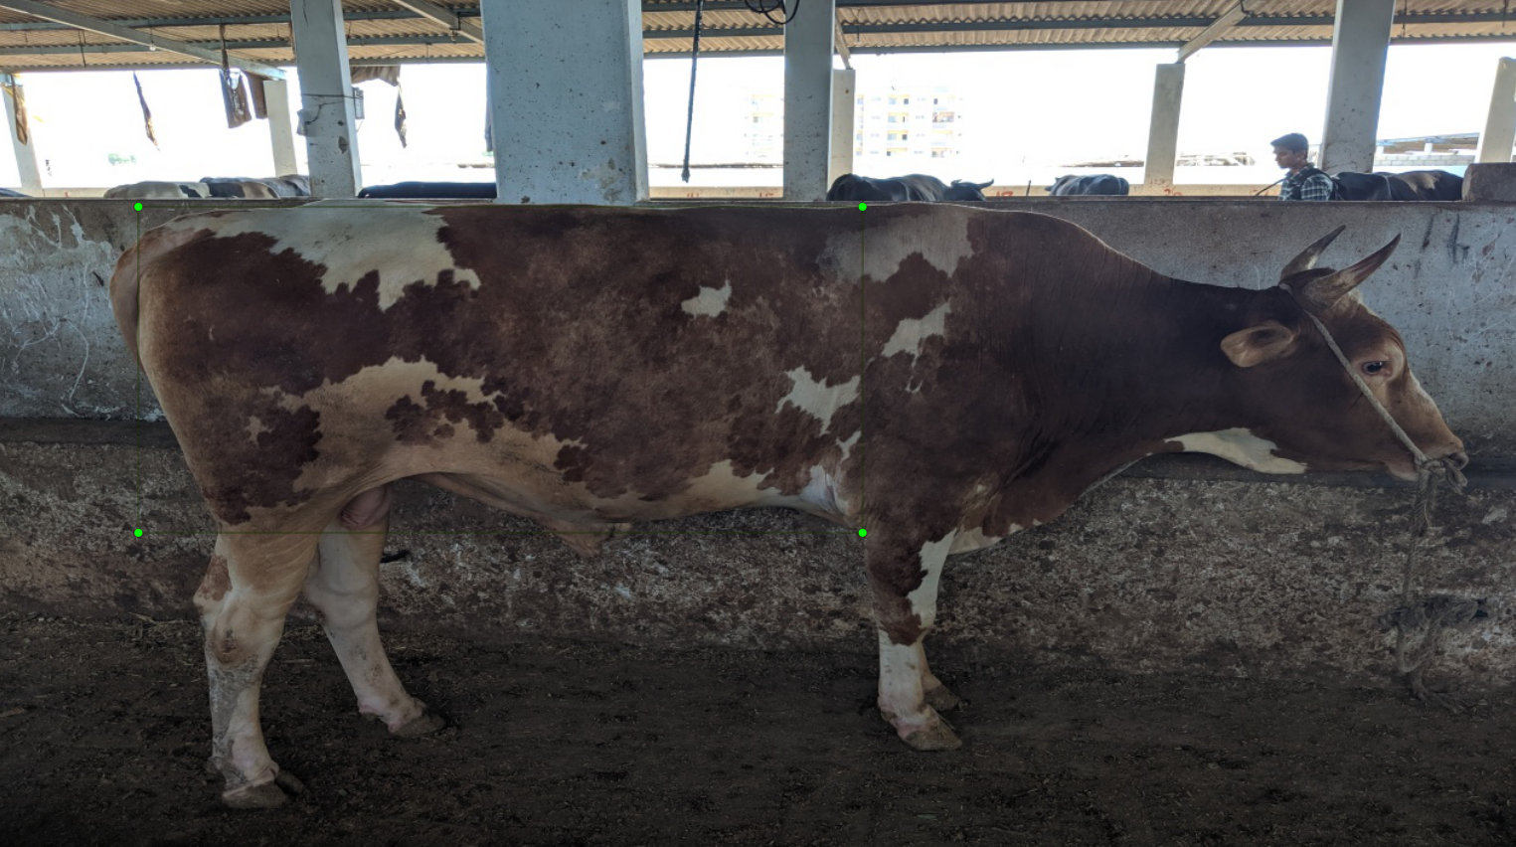
Aim: Object Localization

Slide 27
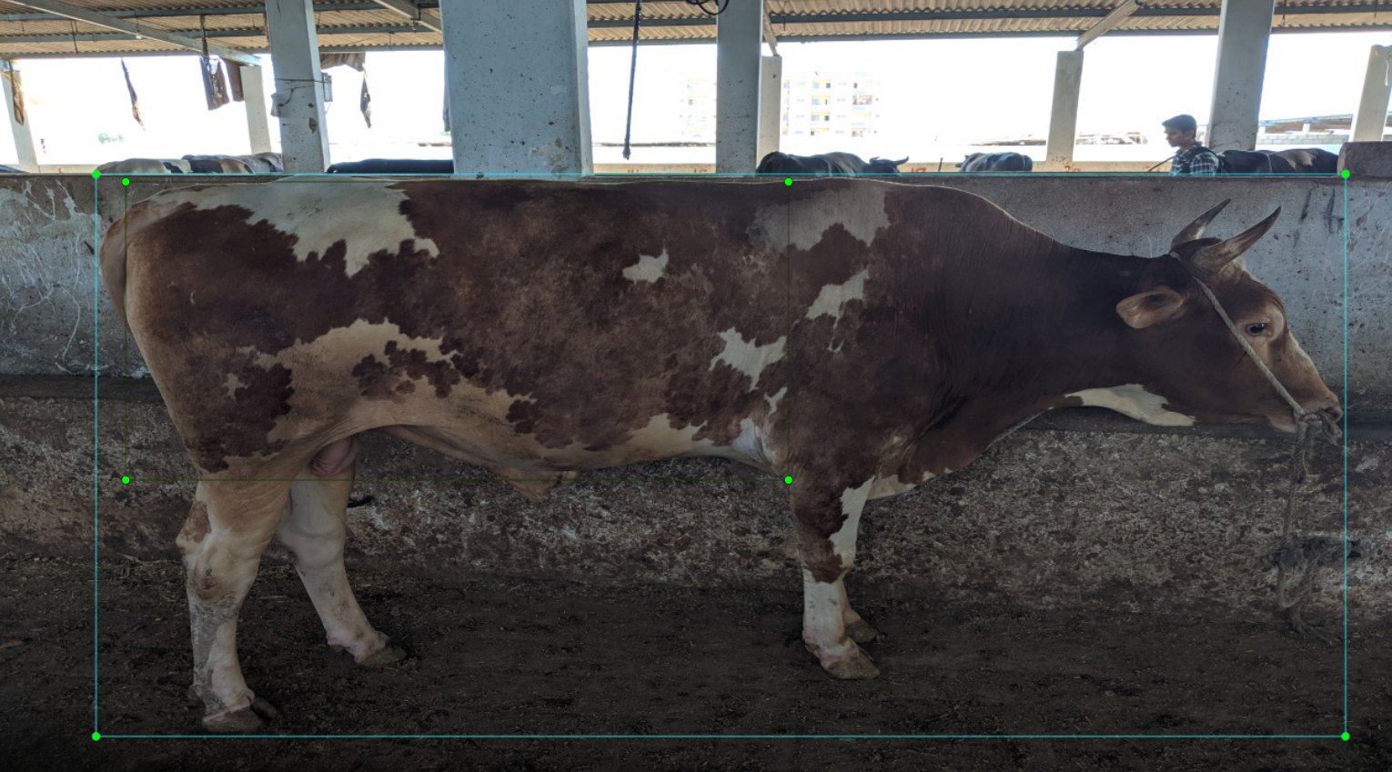
Combined Both

Slide 28
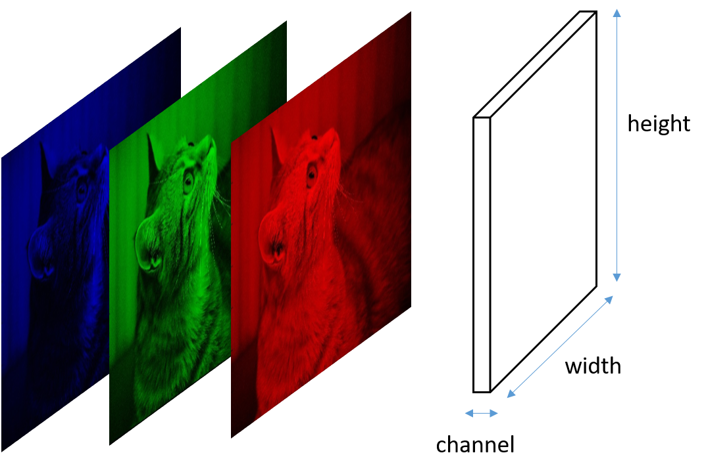
NN for Images
Consider Simple neural network for classifying classes C1 and C2
1
1
2
2
3
c1
.
.
.
4
c2
5
1152 + 12 = 1164 weights
192
6
8x8 image with 3 channels
192x6 = 1,152‬
6x2 = 12

Slide 29
Problem with Dense Network
Need higher number of input neurons
Need high number of hidden layers to extract good features, hens results in higher number of learning parameters
Learning time, vanishing gradients, etc.

Slide 30
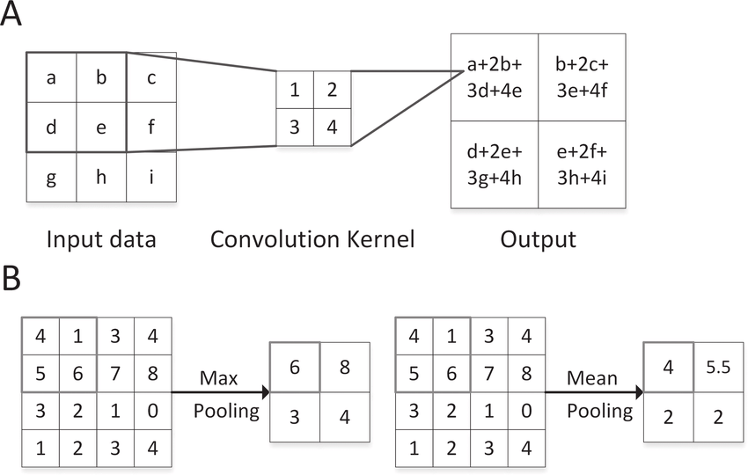
Convolution NN

Slide 31
Trained My own CNNs
1
2
3
Bbox 1
4
12x12
5x5
3x3
5
6
Bbox 2
7
8

Slide 32
Transfer Learning
Use a pre-trained model for features extraction and add you model to trin on the features extracted by base network

Slide 33

Architecture of VGG 16

Slide 34
Current Network
My network
+

Slide 35
Dataset V2
Hand annotated images with depth: 1100
Only side views of Cattle
No weight labels
Will be use for Semantic Segmentation and Cattle detection
Total Images 1,100 with depth , 2,116 without depth

Slide 36
Experiment on Dataset V2
Cropped Cow Images and tried to predict inner bounding box
Assumption was it will learn better features because it has less background compare to the whole image but didn’t worked.

Slide 37
Image Preprocessing

Slide 38
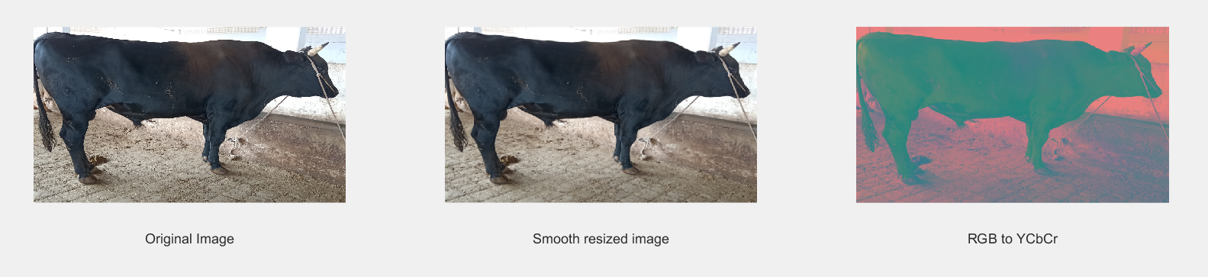
Goal: Preprocessing

Slide 39
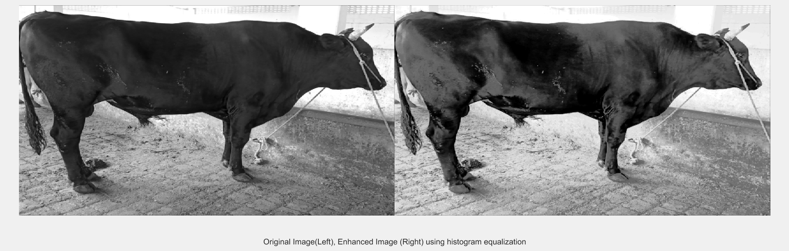
Goal: Preprocessing (Smoothing & Contrast Enhancement using Histogram Equalization)

Slide 40
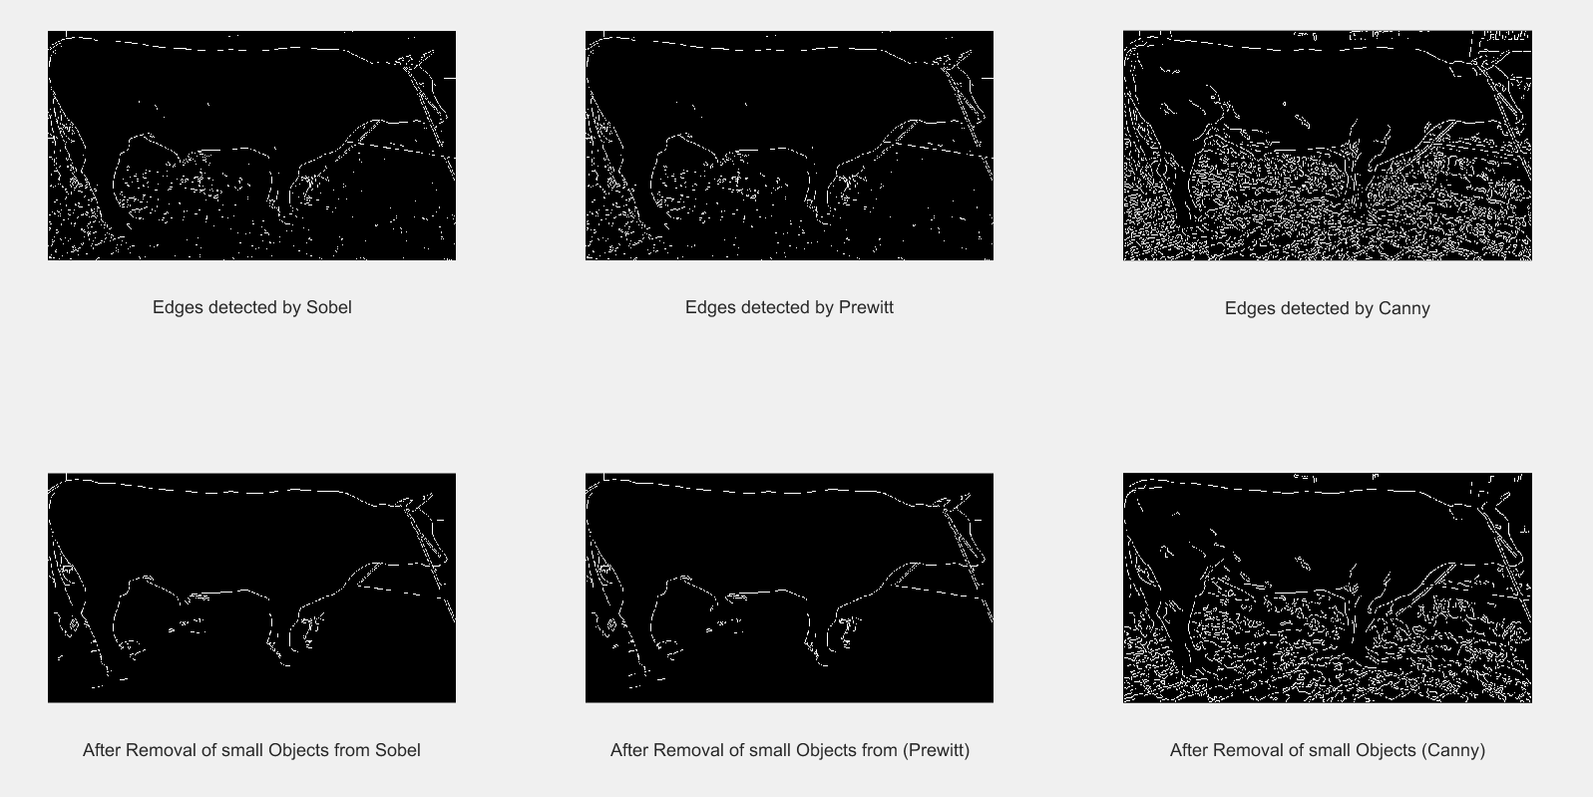
Goal: Preprocessing (Edge Detection)

Slide 41
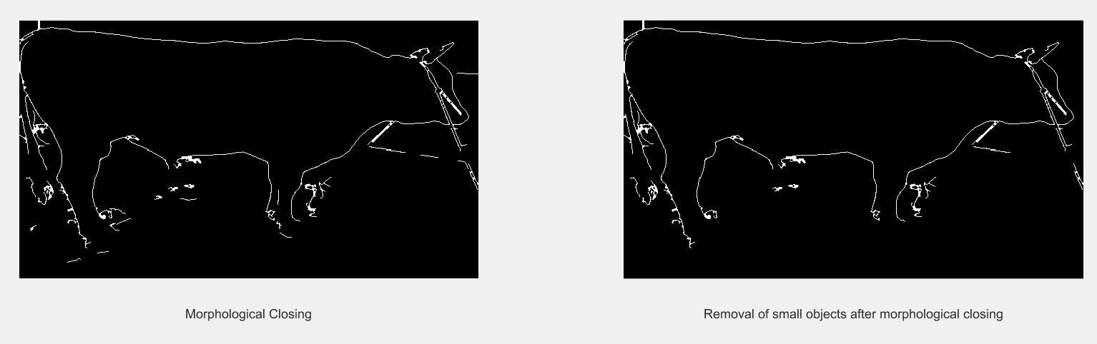
Goal: Preprocessing (Morphological Processing)

Slide 42
Image Segmentation

Slide 43
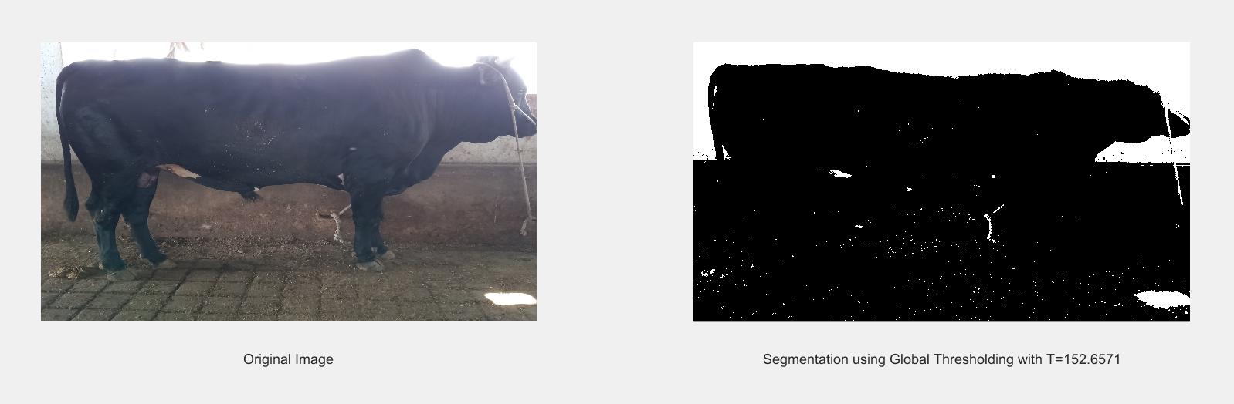
Goal: Segmentation (Global Thresholding)

Slide 44
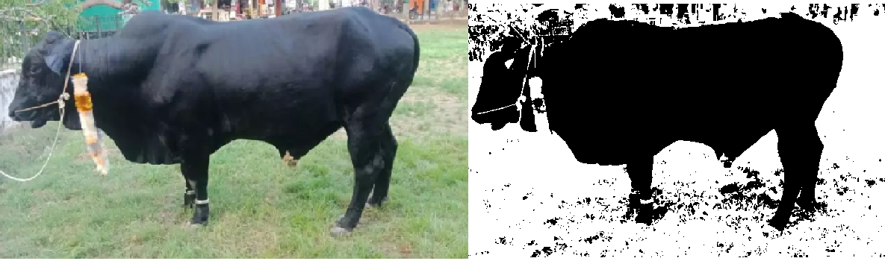
Goal: Segmentation (Otsu’s Thresholding)

Slide 45
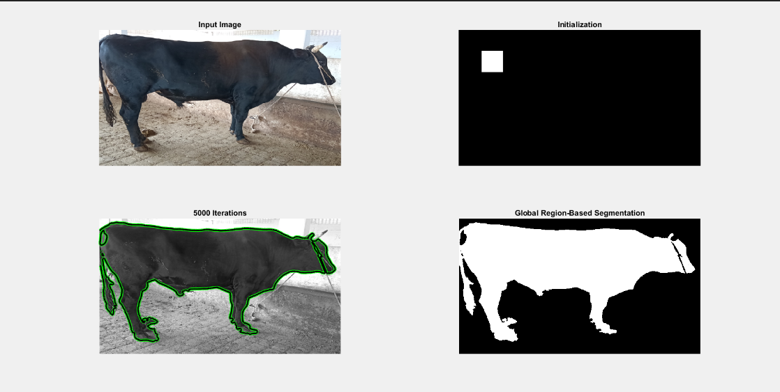
Goal: Segmentation (Region Based)

Slide 46
Future directions
Train Yolo and SSD - For inner box detection.
Train Binarized or Gray Scale depth images.
Using Depth Values - Get Cow from YOLO
Using Heuristics and Brute Force - Get Area of Interest
If approach fails - Next approach “Semantic Segmentation”

Slide 47
Challenges
Weight Labelled Dataset

Slide 48
References
Kashiha, Mohammadamin & Bahr, C. & Ott, Sanne & Moons, Christel & Niewold, Theo & Ödberg, Frank & Berckmans, Daniel. (2014). Automatic weight estimation of individual pigs using image analysis. Computers and Electronics in Agriculture. 107. 38–44. 10.1016/j.compag.2014.06.003.
Livestock Industry." Dictionary of American History. . Retrieved August 31, 2019 from Encyclopedia.com: https://www.encyclopedia.com/history/dictionaries-thesauruses-pictures-and-press-releases/livestock-industry
Begaz, S. and K. Awgichew,. 2009. "Estimation of weight and age of sheep and goats”,."
Kashiha, M., Bahr, C., Ott, S., Moons, C., Niewold, T., Ödberg, F. and Berckmans, D. (2014). Automatic weight estimation of individual pigs using image analysis. Computers and Electronics in Agriculture, 107, pp.38-44.
Pradana Z., B. Hidayat, and S. Darana. 2016. "Beef Cattle Weight Determine by Using Digital Image Processing."
Mahdi Khojastehkey, Ali Asghar Aslaminejad, Mohammad Mahdi Shariati & Rouhollah Dianat (2016) Body size estimation of new born lambs using image processing and its effect on the genetic gain of a simulated population, Journal of Applied Animal Research, 44:1, 326-330, DOI: 10.1080/09712119.2015.1031789
Using body measurements to estimate live weight of dairy cattle in low-input systems in Senegal
Stanly Fon Tebug,Ayao Missohou, Souahibou Sourokou Sabi, Jarmo Juga, Elizabeth Jane Poole,Miika Tapio &Karen Marshall show less
Pages 87-93 | Received 07 Jun 2016, Accepted 11 Nov 2016, Published online: 08 Dec 2016
https://alexisbcook.github.io/2017/global-average-pooling-layers-for-object-localization/
http://cnnlocalization.csail.mit.edu/Zhou_Learning_Deep_Features_CVPR_2016_paper.pdf

Slide 49
Demo

